Slide 1


Web Analytics using Kafka
Purnima Kamath
@purnimakamath
https://www.linkedin.com/in/purnimakamath/
Director, Women Who Code Singapore
Evangelist YOW! Conference

Slide 2
Web Analytics using Kafka
@purnimakamath
Agenda
What do I mean by Web Analytics?
The 1st Problem
Kafka – What & How
Intro to Pub/Sub
Kafka intricacies
Streams!
The 2nd Problem
Demo

Slide 3



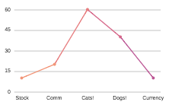


What is Web Analytics?
@purnimakamath
You
Client

Slide 4




The 1st Problem
@purnimakamath
Typical subscribers range in the 100,000’s
Volumes typically high for plain web servers to handle
Very high request drop rates because of request build up
Response times dictated by slower DB writes

Slide 5


Enter Kafka!
@purnimakamath
A distributed commit log
Developed by engineers at Linked In
Throttles events by queuing them, to be processed later
Supports multiple producers and consumers (Pub/Sub)

Slide 6
What is Pub/Sub?
@purnimakamath
Queues/Topics in a Nutshell
IN
6
5
4
3
2
1
OUT
Most commonly used Enterprise Integration pattern
Guaranteed Ordering
Events remain on queue unless read
Single subscriber (Queues)
Multiple Subscribers (Topics)
Cluster
Broker-1
T1
Broker-2
T2
Broker-3
T3

Slide 7
Kafka in depth
@purnimakamath
Distributed Commit Log
IN
101
100
5
4
3
2
1
OUT
102
Cluster
Partitioned
Replicated
Ordered
Clustered (Uses zookeeper)
Multiple subscribers via Consumer Groups
Commit log makes replays possible (consumer offsets)
Broker-1
T1
(Primary)
Consumer
Consumer Offsets
Consumer
Producer
Consumer
Broker-2
Producer
T1
(Replica)
Producer
T2
(Replica)
Consumer
Consumer
Broker-3
Consumer
T2
(Primary)
Consumer Offsets

Slide 8
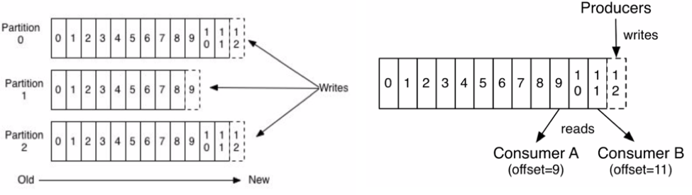
Kafka in depth
@purnimakamath
Partitions and consumer offsets are the best part of Kafka
Partitions can live on the same node or different nodes
Multiple consumers & producers can consume and produce simultaneously *
Consumer offsets are also replicated
Consumer offsets make replays possible
Source: confluent.io blog (see references slide)

Slide 9
Why do I like Kafka?
@purnimakamath
Is it different than say MQ or Tibco EMS?
Not very (Theoretically)
It’s simply a log – nothing else
Everything can be persisted
Easy to install
Open Source
ACK’s are easily configurable per Topic – Making it faster
Replays!

Slide 10
The 2nd Problem
@purnimakamath
”Data Lake”
Cluster
Broker-1
T1
(Primary)
T2
(Replica)
Reader | Article Read | Read Time
Purnima | XyZ | 28th July 5pm
Marianne |  | 1st Aug 1pm
 | AbC | 10th July 2pm
T2
Broker-2
(Primary)
Analytics Data
Users Data
T1
(Replica)
T1
Broker-3
(Replica)
T2
(Replica)
Article/Blog Data

Slide 11
What are Kafka Streams?
@purnimakamath
Kafka achieves ETL (Extract Transform Load) using Streams.
Kafka Streams:
A stream is an ordered, replayable, and fault-tolerant sequence of immutable data records
They represent an unbounded, continuously updating data set.
Client Side libraries
Real time (instead of normal ETL, happens over mid night)
Kafka Tables:
A table is an abstraction of a stream
Each record is an “update” to the streams data set
Client Side Libraries.

Slide 12
What are Kafka Streams?
@purnimakamath
Cluster
Consumer
Consumer
Broker-1
Micro services
T1
(Primary)
KStreams
Consumer Offsets
Micro services
Broker-2
T1
(Replica)
T2
(Replica)
Broker-3
T2
(Primary)
Consumer Offsets
Article/Blog Data
Users Data

Slide 13
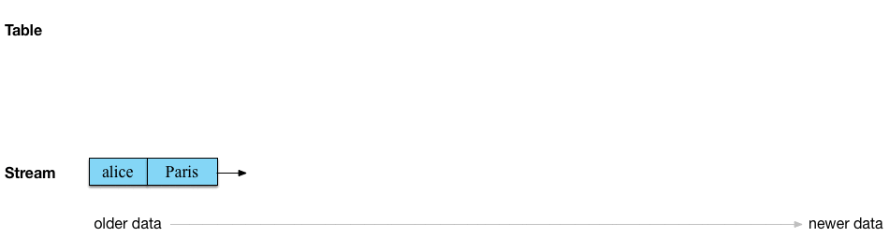
What are Kafka Streams?
@purnimakamath
A good explanation for stream table duality.
Source: Michael Noll’s blog (see references slide)

Slide 14
@purnimakamath
Demo ?

Slide 15

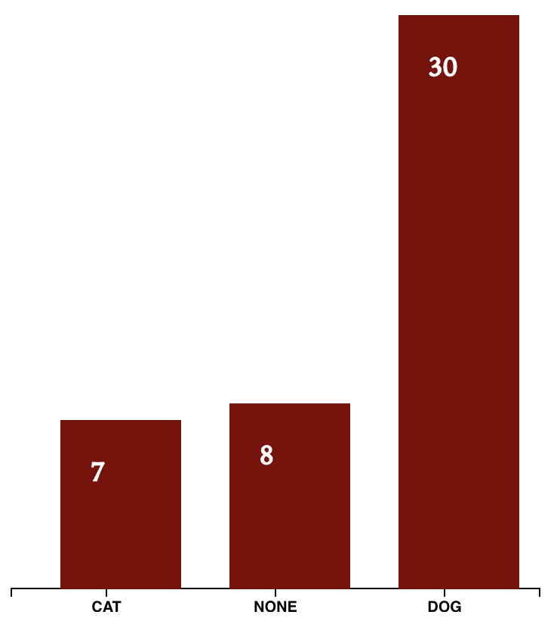
Demo Topology
@purnimakamath
Cluster**
Broker-1**
WEB_ANALYTICS_IN
IN
KStreams
Microservice
WEB_ANALYTICS_OUT
OUT
KStreams
Device Change Log
Device
State Store
Pet
State Store
Preferred Pet Change Log
Gender Change Log
Gender
State Store
Browser
State Store
Observable Notebook
Browser Change Log
**Simplified for brevity
Topics: 3
Brokers: 5
Partitions for each topic: 12
Replication factor: 3
Notes:
State stores use Chagelogs topics to stay fault tolerant.

Slide 16
Stats & Other things
@purnimakamath
Kafka in LinkedIn processes 1.4 trillion messages, deployed across 1400 brokers
O’Reilly Strata Conference Singapore – every other talk/project used Kafka!
Netflix uses Kafka in their streaming pipeline (called Keystone). This system processes 2 trillion messages per day!
NYTimes uses Kafka’s distributed log as a source of truth for their article archives

Slide 17


Further reading…
@purnimakamath
Books
Videos
YOW! Night - Go back to the future with event sourcing & CQRS : https://engineers.sg/v/2793
Building Data Intensive applications : https://www.youtube.com/watch?v=KIiq8lIgUVk
Code
https://github.com/pkamath2/web-analytics-capture
https://github.com/pkamath2/web-analytics

Slide 18
Further reading…
@purnimakamath
References used in the slides –
Kafka in LinkedIn - https://engineering.linkedin.com/blog/2016/04/kafka-ecosystem-at-linkedin
Michael Noll’s blog for Kafka streams: https://www.michael-noll.com/blog/2018/04/05/of-stream-and-tables-in-kafka-and-stream-processing-part1/
NY Times on how they use Kafka: https://open.nytimes.com/publishing-with-apache-kafka-at-the-new-york-times-7f0e3b7d2077
Confluent blog on Kafka Streams: https://www.confluent.io/blog/introducing-kafka-streams-stream-processing-made-simple/
Consumer offsets deep dive: https://www.sderosiaux.com/2017/08/07/looking-at-kafka-s-consumers-offsets/

Slide 19
Thank you
@purnimakamath
https://www.linkedin.com/in/purnimakamath/

Slide 20


Slide 21


